Slide 1


Green Pace
Security Policy Presentation
Developer: Connor Blauch

Slide 2

OVERVIEW: DEFENSE IN DEPTH

Slide 3
THREATS MATRIX
Likely STD-002-C++ STD-004-C++ STD-005-C++ STD-008-C++ STD-009-C++ | High Prio STD-001-C++ STD-003-C++ STD-004-C++ STD-007-C++
Low Prio STD-002-C++ STD-005-C++ STD-006-C++ STD-008-C++ STD-009-C++ STD-010-C++ | Unlikely STD-001-C++ STD-003-C++ STD-006-C++ STD-007-C++ STD-010-C++

Slide 4
10 PRINCIPLES
Validate Input Data
Heed Compiler Warnings
Architect and Design for Security Policies
Keep it Simple
Default Deny
Adhere to the Principle of Least Privilege
Sanitize Data Sent to Other Systems
Practice Defense in Depth
Use Effective Quality Assurance Techniques
Adopt a Secure Coding Standard

Slide 5
CODING STANDARDS
Data Type
Data Value
String Correctness
SQL Injection
Memory Protection
Assertions
Exceptions
Object Oriented Programing
Input Output
Integers

Slide 6
ENCRYPTION POLICIES
In Flight
Data being stored needs to be encrypted so it can not be accessed by anyone who should not have access to it
At Rest
When transferring data that is sensitive or considered classified, it should be encrypted to stop anyone who should gain access to having access
In Use
When accessing data, you should have it encrypted, just so no one can see what you are working on that shouldn’t see it

Slide 7
TRIPLE-A POLICIES
Authentication
Authentication allows for a check to be made top make sure the person who is logging in, is who they are supposed to be
Authorization
Authorization allows for a check to be made for whoever is logging in, so they have access to the right information they should have
Accounting
Accounting means keeping track of what everyone is doing when accessing the software from the company. This just keeps everyone accountable so if they do something wrong, it can be delt with fast

Slide 8

AUTOMATION SUMMARY

Slide 9
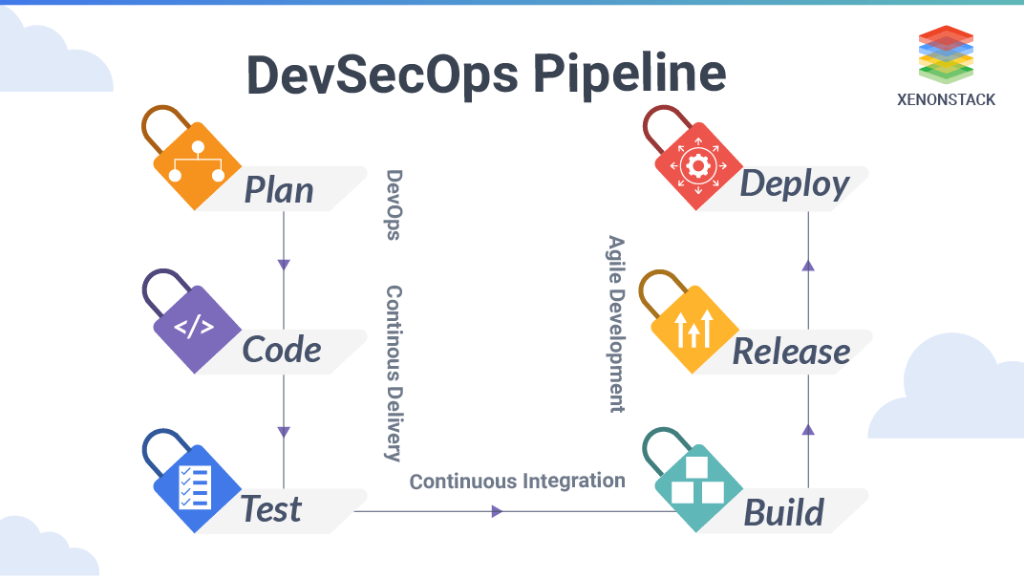
TOOLS
Makes sure you are focusing on security during the entire process of creating software.
Limits mistakes
Saves Time
Automation when it comes to following the DevSecOps Pipeline has become more of the focus
Allows for easier fixing later in life
No Need to try and fix security issues on other software

Slide 10
RISKS AND BENEFITS
The main problems are not taking in account for security flaws while designing software or setting up software
The solution is to go back and fix everything now
Then from now on keep track of security flaws and fix as you are going through
If you wait it will just cause issues further down the line
The main thing that is lacking is using automation tools to help with these issues
The main risk is having exploits in your software that could leave to data leaks

Slide 11
RECOMMENDATIONS
No Plan for Flaws
No Understanding of how to fix flaws
No automation
Not following DiD
No clear security policy for employees and users

Slide 12
CONCLUSIONS
Overall, the entire security policy needs reworked
Need to account for more than what was originally accounted for
Allows for multiple solutions to single problems
Follow Defense In Depth
Use Automation
All the tools recommended prior
CPP check
CODACY
GitLab

Slide 13
REFERENCES
What is DevSecOps? Red Hat - We make open source technologies for the enterprise. (n.d.). https://www.redhat.com/en/topics/devops/what-is-devsecops.
Confluence. SEI CERT C++ Coding Standard - SEI CERT C++ Coding Standard - Confluence. (n.d.). https://wiki.sei.cmu.edu/confluence/pages/viewpage.action?pageId=88046682.
DevSecOps Tools To Integrate Throughout The DevOps Pipeline. WhiteSource. (2021, May 26). https://www.whitesourcesoftware.com/resources/blog/devsecops-tools/.

